Slide 1
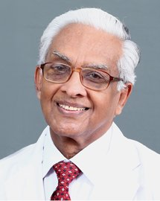
AFFILIATION: Senior Consultant Nephrologist - Calicut
Former Professor and Head , Department of Nephrology ,
Govt. Medical College , Calicut
Presently Professor and Head Department of Nephrology,
Baby Memorial Hospital , Calicut
PUBLICATIONS : More than 100 publications in various Journals .
ACHIEVEMENTS AND AWARDS : First qualified Nephrologist in Kerala state .
Started the first Dialysis and Transplant center in Kerala state .
Best Doctor award by the Govt. of Kerala state
Best Doctor award by the API - Kerala chapter
Best Doctor award by the IMA - Calicut
Life Time Achievement Award’ of Southern Chapter of Indian Society of Nephrology Life Time Achievement’ Award of Association of Physician of India,
‘Scribner Award’ of ISN – SC
The ‘Distinguished Professorship Award’ of the Institute of Kidney Disease, Ahmedabed.
Prof. M. THOMAS MATHEW

